Slide 1
Kinase Selectivity Prediction
By The Kinines

Slide 2
Table of contents
1
2
3
4
Problem Overview
Methodology
Results
Conclusion

Slide 3

01
Problem Overview

Slide 4
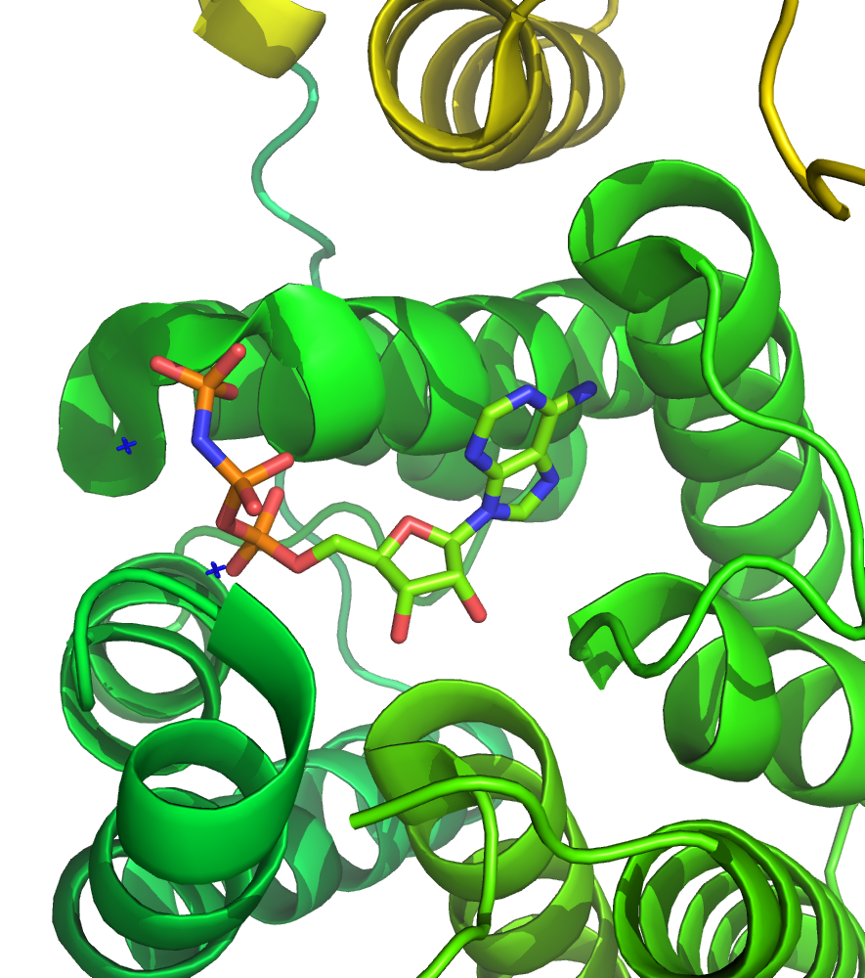
Introduction
Kinases regulate cellular functions and are key drug targets.
Challenge: Predicting a kinase selectivity to minimize off-target effects.
Goal: Use classification to predict whether an inhibitor binds to a kinase at:
Kd < 300nM (strong binder)
Kd < 3000nM (moderate binder)
https://www.google.com/url?sa=i&url=https%3A%2F%2Fen.wikipedia.org%2Fwiki%2FKinase&psig=AOvVaw3qc3gwWUUHQpn83yolX7UJ&ust=1742227036093000&source=images&cd=vfe&opi=89978449&ved=0CBUQjRxqFwoTCKiMitD7jowDFQAAAAAdAAAAABAE

Slide 5
Dataset & Feature Engineering
Dataset Overview:
442 kinases, 60 inhibitors (48 train, 12 test)
SMILES strings for compounds, kinase families, and selectivity scores
Explorations:
Preprocessing: SMILES to molecular fingerprints (ECFP4), kinase embeddings (ProteinBERT)
Data balancing: Handling class imbalance using class weights

Slide 6
02
Methodology

Slide 7
Strategy and Solution
Approach
Separate binary classifications for 300 nM and 3000 nM thresholds.
Using features:
ECPF encoding for inhibitors (512 features)
ProteinBERT embedding of the Kinases (PCA keeping 95% variance) (50k → ~100 features)
Tools
RDKit for molecular fingerprints ⇒ capture compound structure
XGBoost for classification ⇒ handles imbalanced data and provides interpretability.
ProteinBERT for kinase embeddings ⇒ capture protein sequence information.

Slide 8
Attempts
Attempt # | Name | Details
1 | XGBoost Regression (baseline) | ECPF4 fingerprints from RDKit and a XGB model
2 | XGBoost Multiclass Classifier | ECPF4 fingerprints from RDKit and a XGB model
3 | ECFP Sizes | Calibrated ECFP bit length to about 1/10 of example count
4 | SMOTE/SMOTETomek | Applied SMOTE and Tomek to balance under/over-represented data
5 | XGBoost Logistic Classifier | Separated classification into two binary classification tasks
6 | scale_pos_weight | Add balance parameter to XGBoost Logistic Classifier
7 | Threshold calibration | Calibrate threshold for prediction probabilities

Slide 9
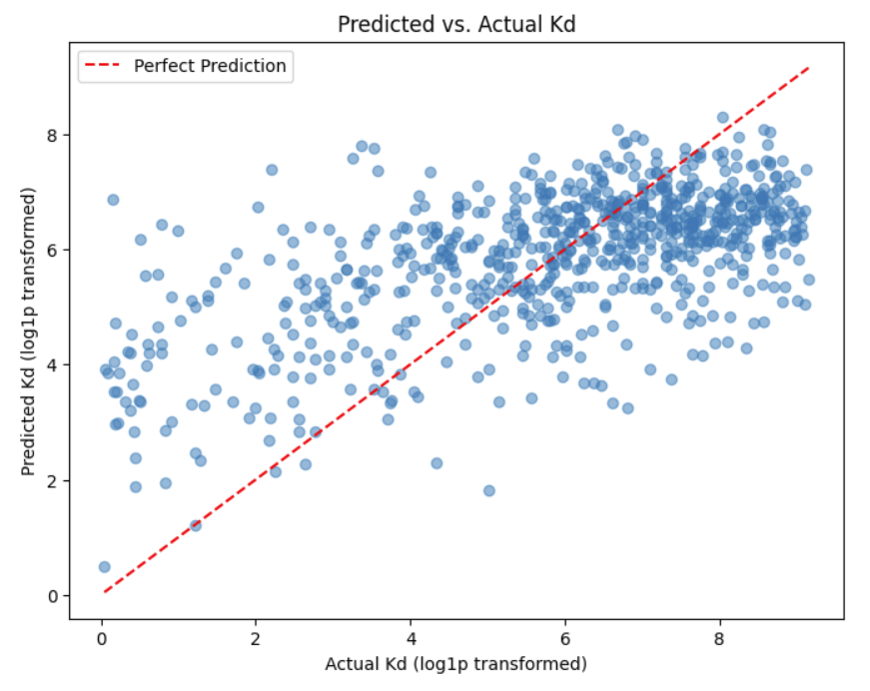
Baseline model
Mean Squared Error: 3.3050043833939533
Mean Absolute Error: 1.4468829188735501
Mean R^2 Error: 0.35691339345649853
Fingerprints only.

Slide 10
Identifying other features
S (300nM)
S(300nM) 1.000000e+00
S(3000nM) 9.301859e-01
Binding Mode (based on ABL1-phos. vs. -nonphos affinity)_Type I 3.808686e-01
Mutant_NO 1.523698e-15
S (3000nM)
S(3000nM) 1.000000e+00
S(300nM) 9.301859e-01
Binding Mode (based on ABL1-phos. vs. -nonphos affinity)_Type I 5.038162e-01
Mutant_NO 1.849854e-15
Didn’t find significant correlations for other features. Tried with binding mode, not a significant improvement over just ProteinBERT embeddings + fingerprints. May have benefited from better exploration of features, or finding some way to incorporate the binding mode more heavily.

Slide 11
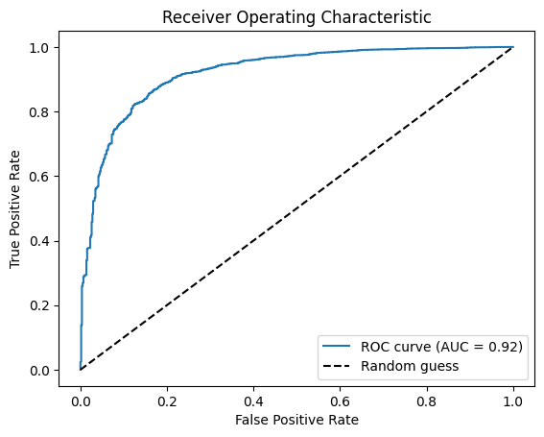
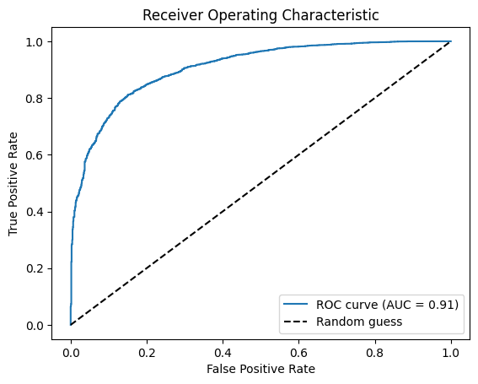
ROC
S(300nM)
S(3000nM)

Slide 12
Model Training & Evaluation
Classification models
Separate models for 300 nM and 3000 nM thresholds
Metrics: Accuracy, Precision, Recall, F1-Score, MSE, Zero-One Loss, Selectivity Score
Validation
Train-test split (80-20)
Stratified sampling to handle class imbalance.
⇒ Adjusted for imbalanced data using scale_pos_weight

Slide 13
Model Training & Evaluation
Parameters
params = {
'objective': 'binary:logistic',
'eval_metric': 'logloss',
'scale_pos_weight': scale_pos_weight,
'max_depth': 3,
'eta': 0.1,
'subsample': 0.8,
'colsample_bytree': 0.8,
}
Experimented with:
Learning rate (best results at 600 steps)
Attempted hyperparameter optimization with GridSearchCV, but took too long to run.

Slide 14
03
Results

Slide 15
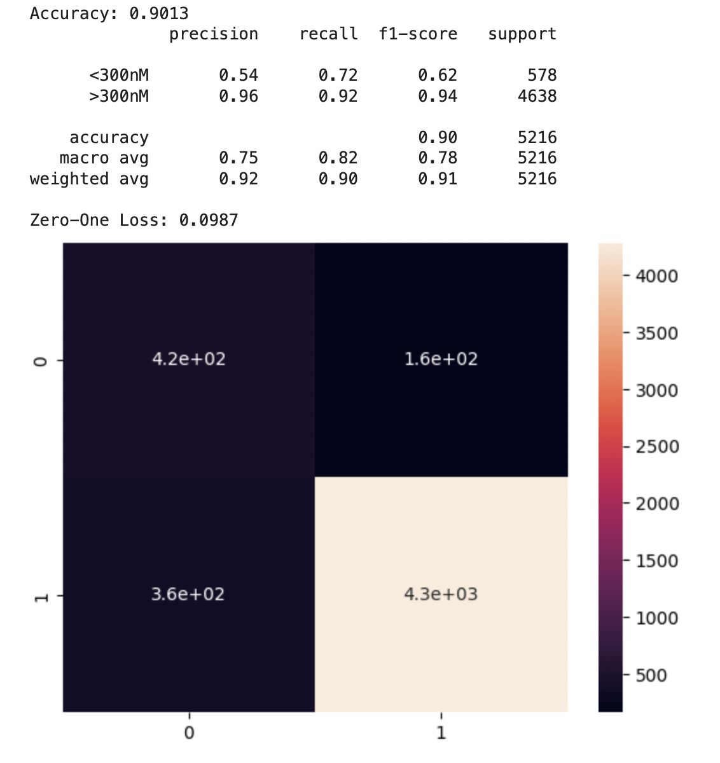
Results - 300nM
Model | Accuracy | F1-Score | Precision | Recall
<300 nM | 0.9013 | 0.62 | 0.54 | 0.72
>300 nM |  | 0.94 | 0.96 | 0.92
Zero-One Loss: 0.0987

Slide 16
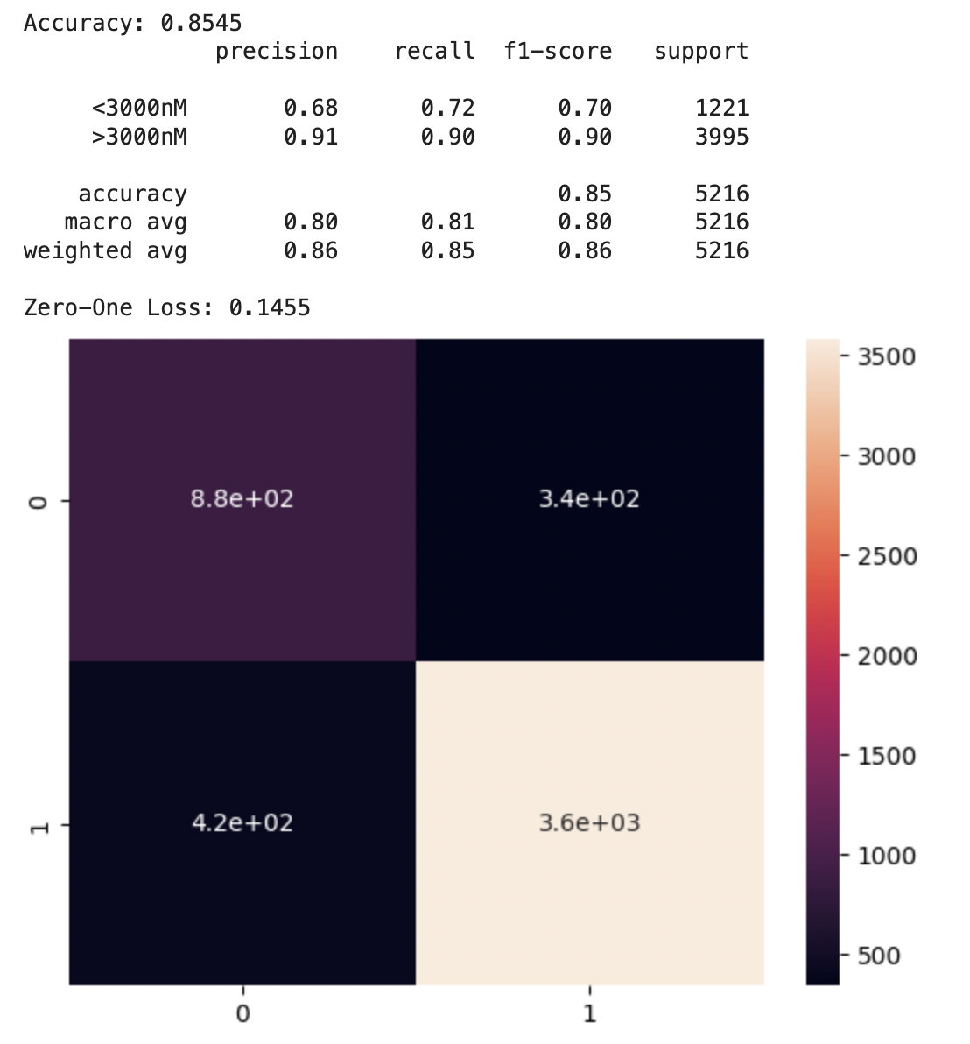
Results - 3000nM
Model | Accuracy | F1-Score | Precision | Recall
<3000 nM | 0.8545 | 0.70 | 0.68 | 0.72
>3000 nM |  | 0.90 | 0.91 | 0.90
Zero-One Loss: 0.1455

Slide 17
Validation and Blind data
Model | Accuracy | F1-Score | Precision | Recall
300 nM | 0.8740 | 0.84 | 0.84 | 0.87
3000 nM | 0.7304 | 0.72 | 0.72 | 0.73
Model | MSE | Zero-One Loss | Mean Selectivity Score (actual)
300 nM | 0.0251 | 0.125 | 0.111
3000 nM | 0.0483 | 0.270 | 0.250

Slide 18
300nM
Compound S(300nM) predicted S(300nM)
0 AMG-706 0.083710 0.0389
1 BIBF-1120 (derivative) 0.067873 0.2927
2 CI-1040 0.176471 0.0026
3 GSK-461364A 0.305430 0.0155
4 PI-103 0.045249 0.0207
5 SKI-606 0.223982 0.1917
6 Sorafenib 0.149321 0.0803
7 SU-14813 0.061086 0.2124
8 Sunitinib 0.018100 0.3109
9 TG-100-115 0.147059 0.0337
10 VX-680/MK-0457 0.210407 0.1321
11 VX-745 0.033937 0.0052

Slide 19
3000nM
Compound S(3000nM) predicted S(3000nM)
0 AMG-706 0.081448 0.0777
1 BIBF-1120 (derivative) 0.210407 0.5181
2 CI-1040 0.117647 0.0078
3 GSK-461364A 0.423077 0.1010
4 PI-103 0.156109 0.0570
5 SKI-606 0.414027 0.4249
6 Sorafenib 0.248869 0.1684
7 SU-14813 0.264706 0.5415
8 Sunitinib 0.074661 0.5959
9 TG-100-115 0.171946 0.1321
10 VX-680/MK-0457 0.346154 0.3472
11 VX-745 0.081448 0.0233

Slide 20
04
Conclusion

Slide 21
Key Findings
Unbalanced Dataset
The greatest challenge was the extreme imbalance in the dataset
Binary predictions
Significant improvement in accuracy after switching to binary predictions
Recall vs. Precision
Some models performed better on recall, while other performed better on precision

Slide 22
Future Research
Multiple Sequence Alignment for Kinase Selectivity Prediction
Identify Commonalities Across Kinase Families:
Perform multiple sequence alignment (MSA) to uncover conserved patterns in:
Active sites – Key residues involved in catalytic activity.
Binding sites – Regions critical for substrate and inhibitor interactions.
Regulatory motifs – Sequences involved in allosteric regulation.
Leverage Embeddings from Common Sequences:
Generate embeddings from aligned sequences to capture evolutionary and functional relationships.
Integrate these embeddings into predictive models to:
Improve kinase-inhibitor binding specificity predictions.
Enhance generalization across kinase families.
Uncover novel selectivity patterns and off-target effects.

Slide 23
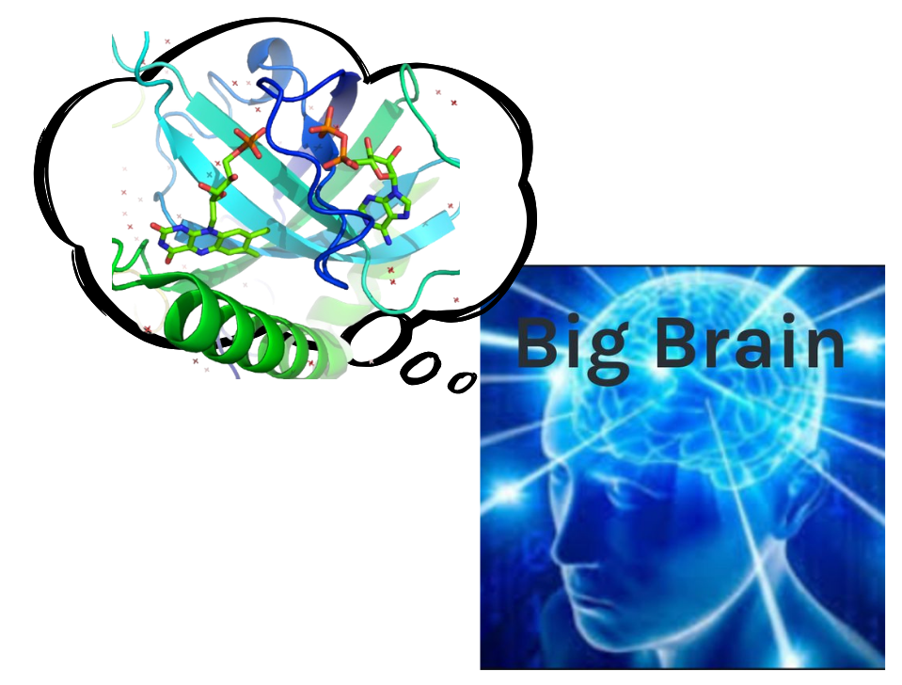
Thanks!
Any questions?

